Slide 1
MCU TNC Design
David Cain, Kobe Keopraseuth, and Kaleb Leon
Design 2 - Final Presentation

Slide 2


Project Overview
What is a TNC?
A modem for connecting a computer with a HAM radio
KISS
AX.25
TNC
TNC

Slide 3
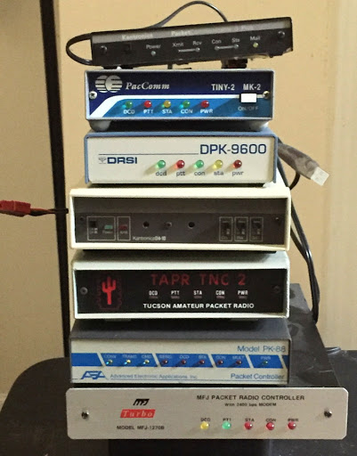
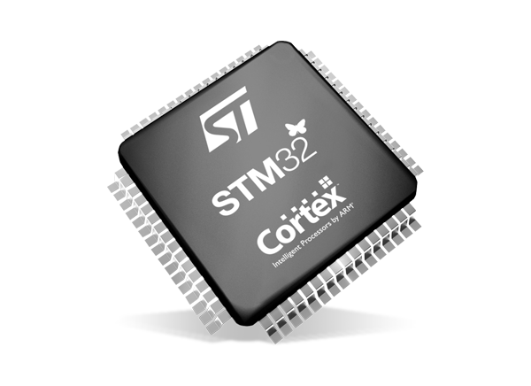
Why every HAMer needs our TNC
VS
Our Solution
Commonly Used Hardware TNCs

Slide 4
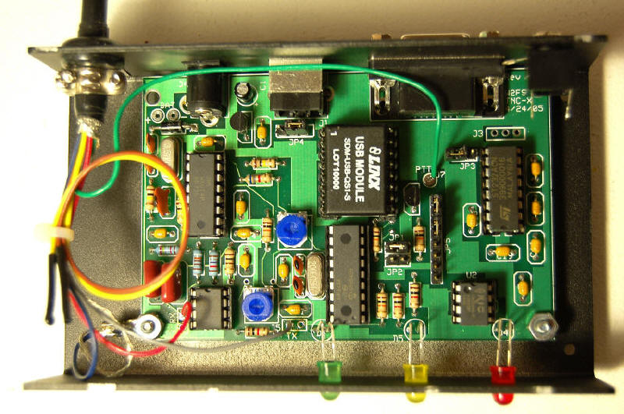
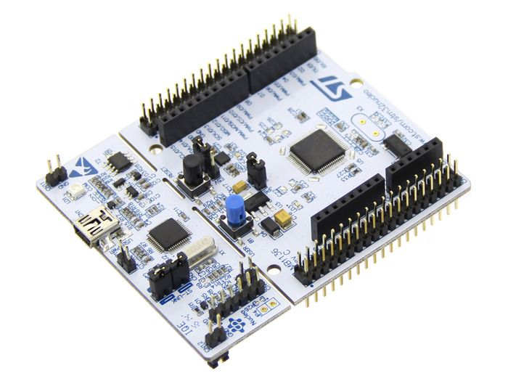
MCU TNC Benefits
Modular/Adaptable
Open Source
Easy to replicate
Small form factor
Well Documented
Increase computational capability
Cheap

Slide 5
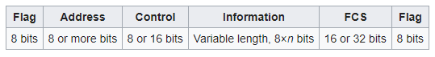
Design Specifications
Scope of Work:
Design, implement, build, and test a TNC with an STM32 or similar microcontroller. The system must accept a string via UART or a similar interface and generate the necessary HDLC headers/packet data and then produce the correct audio waveform.

Slide 6
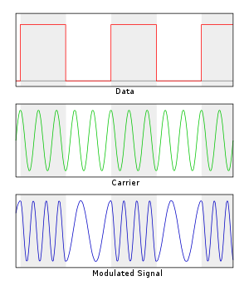
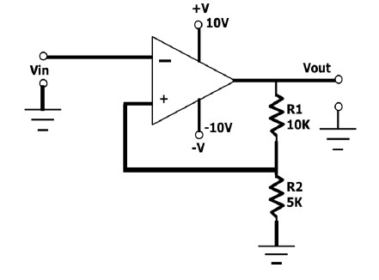
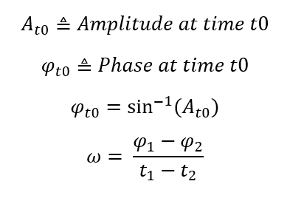
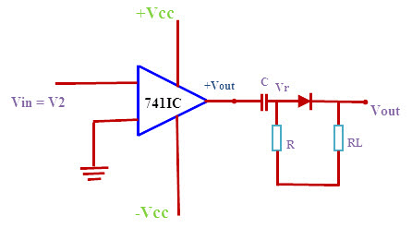
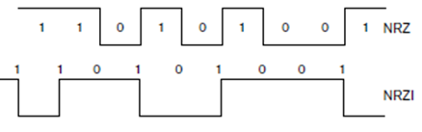
Methodology
Previous Assumptions
Actual Functionality
Schmitt Trigger
Zero Crossing

Slide 7
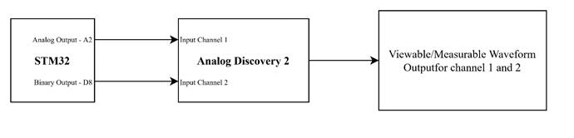
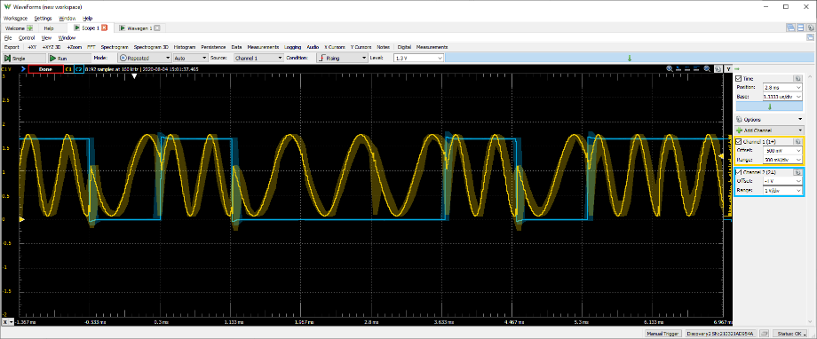
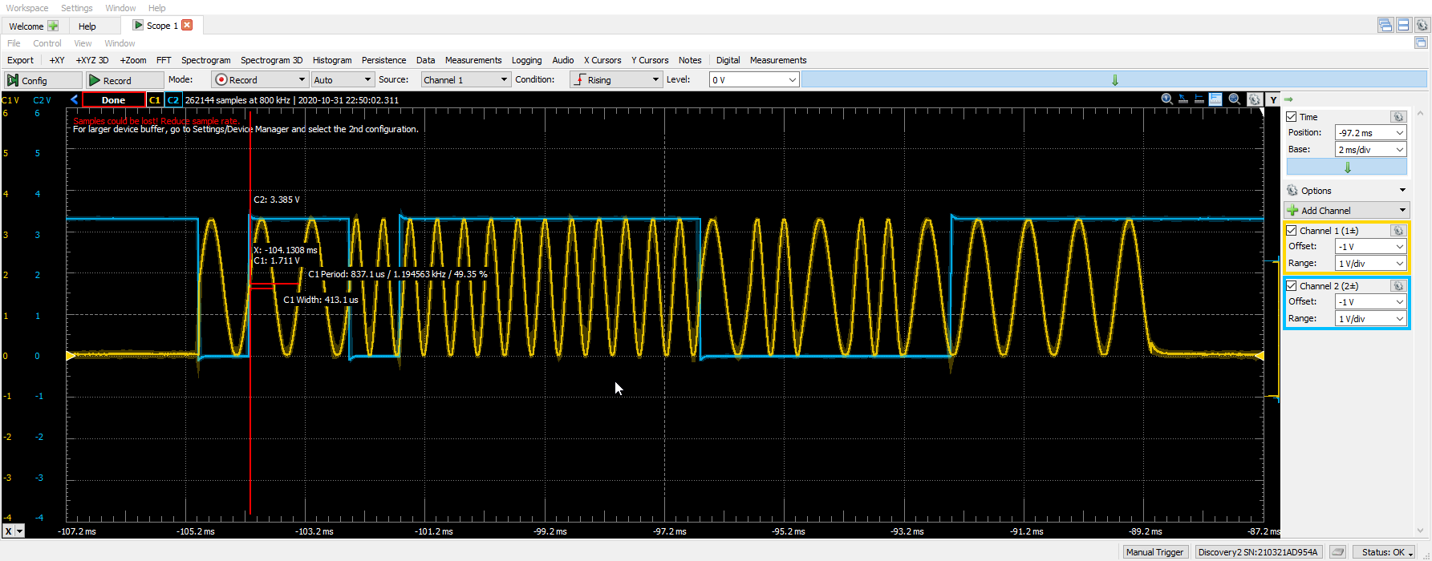
Testing and Validation
Bit Transitions FAIL
Bit Transitions PASS

Slide 8
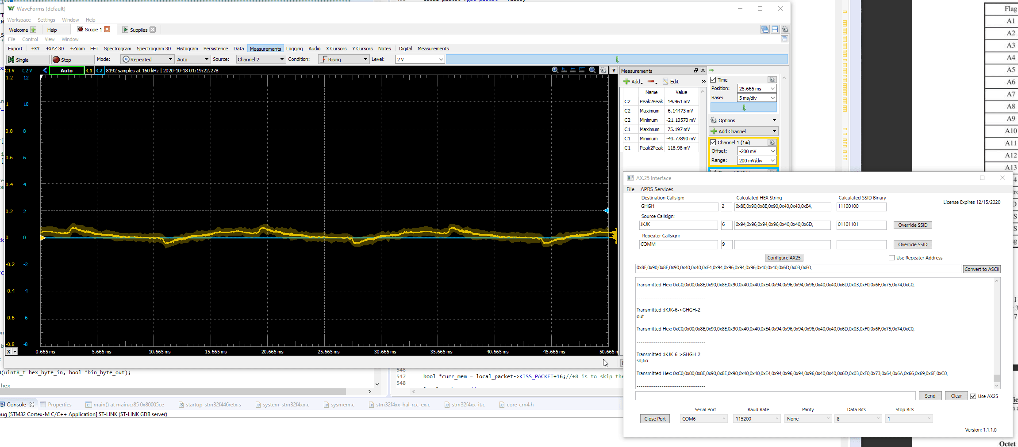
Packet Generation

Slide 9
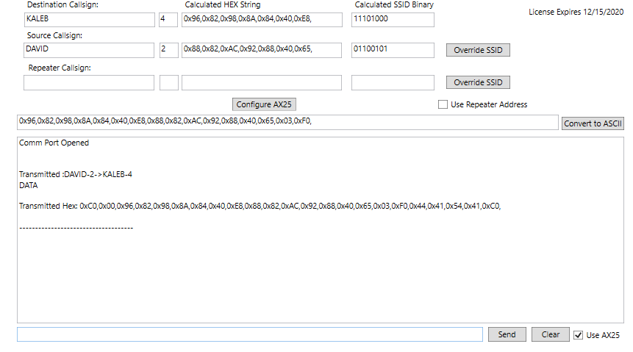
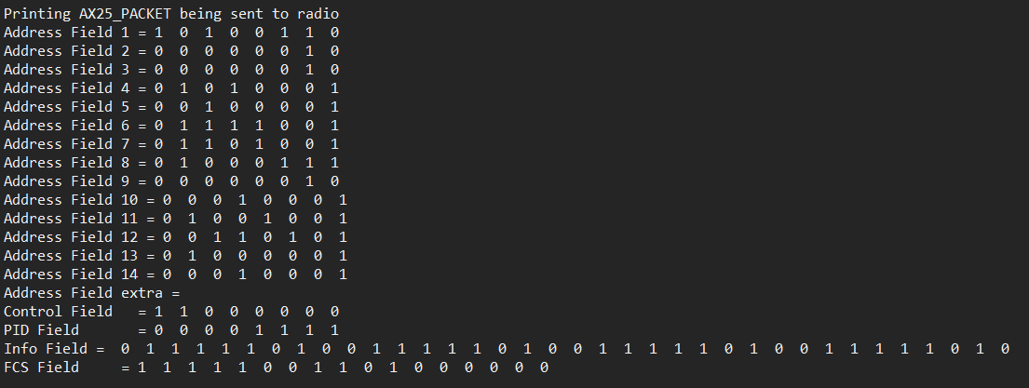
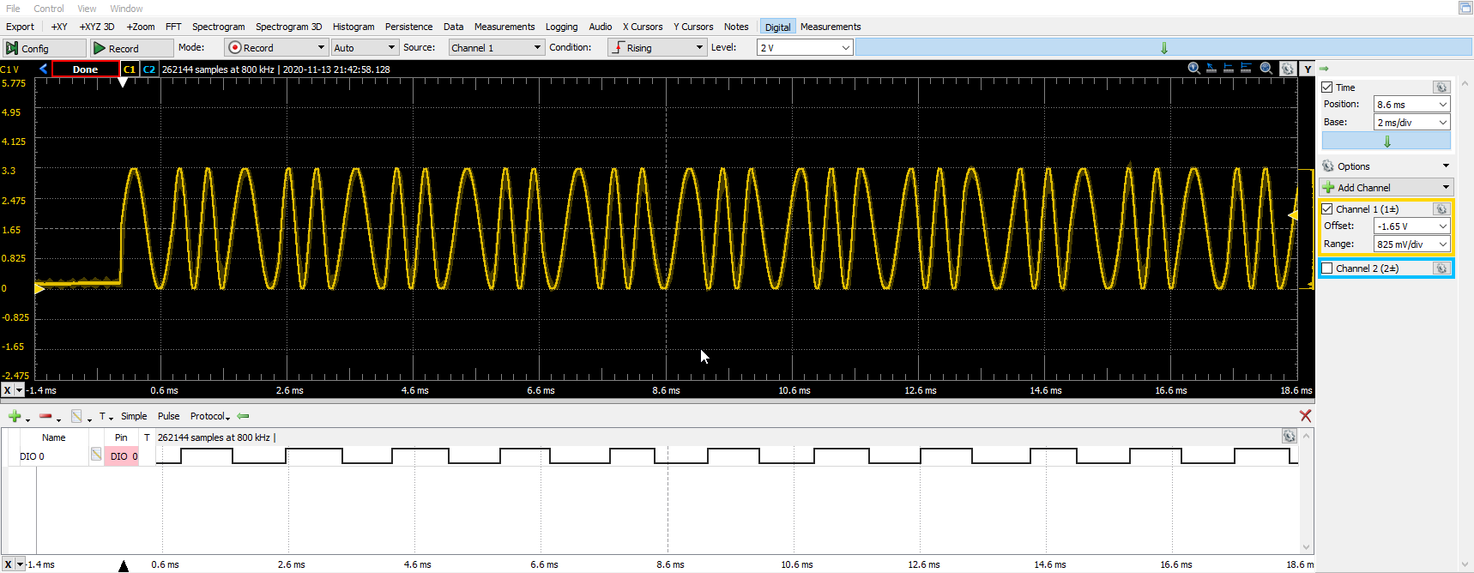
Bit Formatting Validation
Proper Frequency Detection

Slide 10
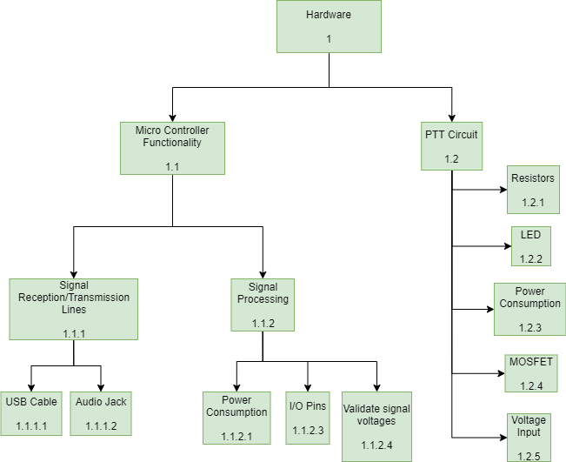
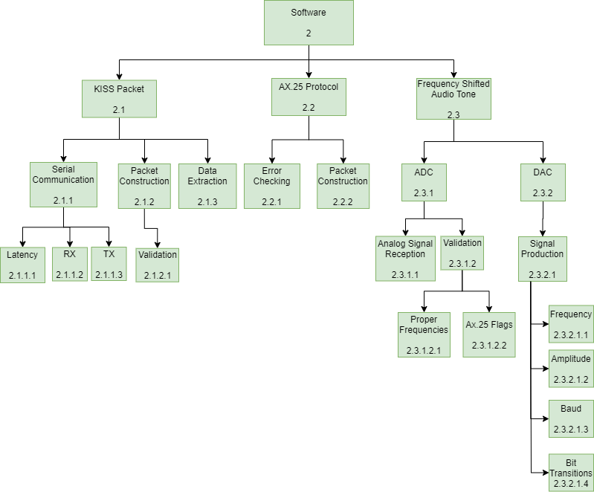
Modular Build, Testing, and Implementation Plan

Slide 11
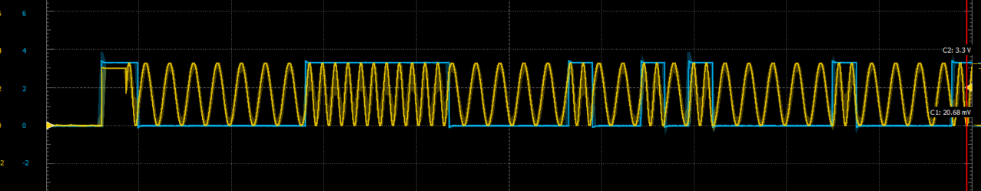
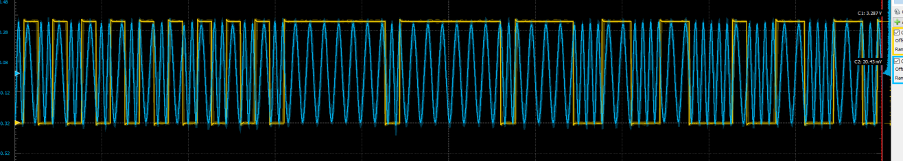
Design Modifications
NRZ
NRZI

Slide 12
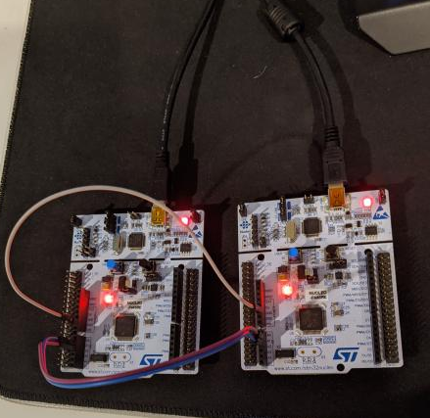
As Built Design

Slide 13
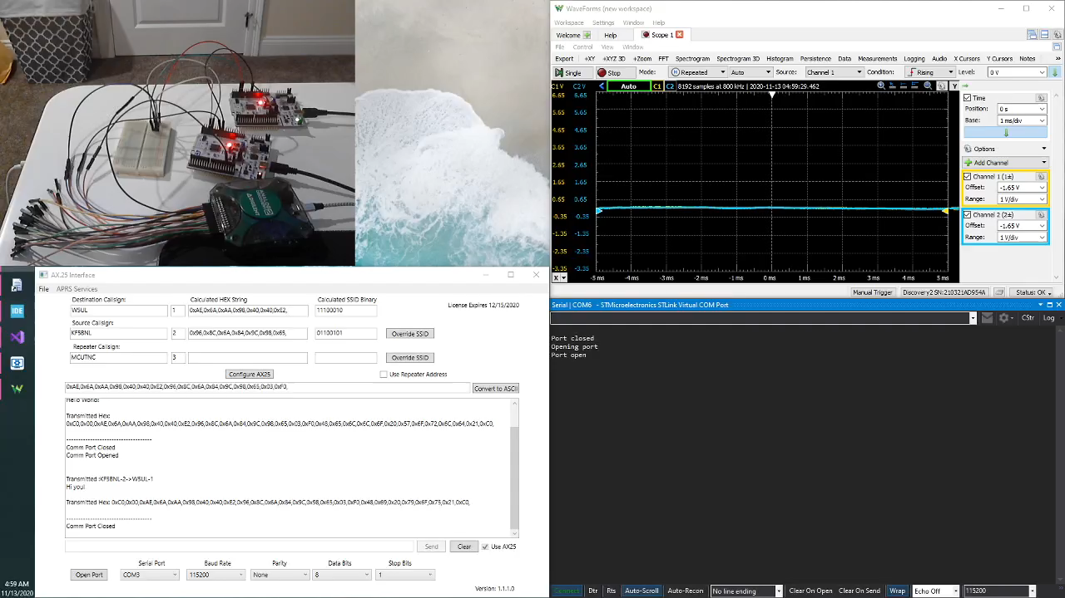
Final Demo

Slide 14
Significance
Future Work
Lessons Learned
APRS - an amateur radio-based system for real time digital communications of information of immediate value in the local area. Data can include object Global Positioning System (GPS) coordinates, weather station telemetry, text messages, etc..
Distinguish between different types of packets
Sending and receiving signals over radio
Document Thoroughly
Cannot trust just one resource
There is no easy way
One change can cause many changes in your design
Plan ahead for life inconveniences

Slide 15
Acknowledgements
Project Mentors
Nolan Edwards
Rizwan Merchant
James Palmer
Nick Pugh
Special Thanks
Pelican Engineering

Slide 16
Questions?

Slide 17
General Information
[1] What is the Baud Rate?
1200
[2] How are we detecting the frequencies?
Basing it off of change in phases over time where we can obtain the phases by performing inverse sine on amplitudes of the signal using the ADC.
[3] How would a normal user interface with your TNC?
Through a dumb terminal that sends KISS packets over UART.
[4] What does KISS stand for?
Keep It Simple, Stupid

Slide 18
Why is our project relevant?
Cost affective
Basic cost of a micro controller
Modular
Code is easily adaptable to add more functionality
Easy to replicate and repair
Grab code off the GitHub and upload to controller
Well documented
Compared to many other TNCs and info about them, ours is very open source

